Slide 1
Data Science 7

Slide 2
Overview
Classification
Model complexity = complexity of the decision boundary
Support Vector Machines / Kernel Machines
Kernels
Orange

Slide 3
Two Classes (blue & red)
Feature 2
Feature 1

Slide 4
Separation by a simple model
(- =decision boundary)
Feature 2
Feature 1

Slide 5

Separation by a complex model
(- =decision boundary)
Feature 2
Feature 1

Slide 6
In classification…
The complexity of a model is the flexibility of the decision boundary
stiff
very elastic
§
increasing complexity

Slide 7
How to determine model complexity?
Depends on complexity of the separation between the classes
Start with the simplest model (large k in kNN), and increase complexity (smaller k)

Slide 8
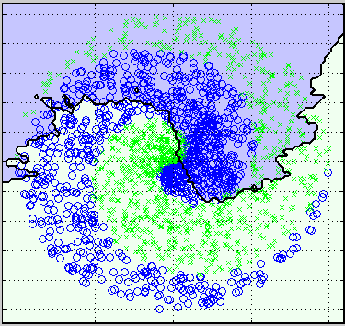
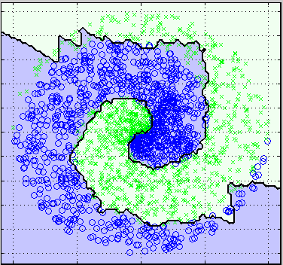
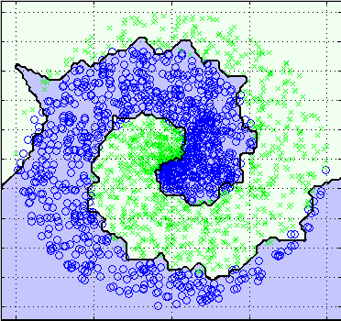
k = 100
k = 10
k = 1
Increasing model complexity

Slide 9
In kNN, the model (decision boundary) is defined by all instances in the training set. That is quite expensive. Can’t we represent the boundary by a few instances only?

Slide 10
Support Vector Machines
a.k.a. Kernel Machines

Slide 11
Simplest SVM
Linear SVM
Places a straight line between the classes (simplest model)
the instances are linearly separable
the instances are not linearly separable

Slide 12
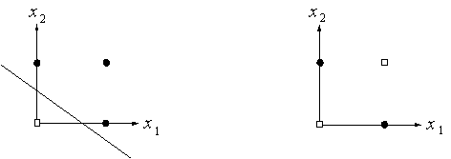
Linearly separable
The instances of the two classes can be separated by a straight decision boundary (OR problem)

Slide 13
Linearly inseparable
The instances of the two classes can not be separated by a straight decision boundary (XOR problem)

Slide 14
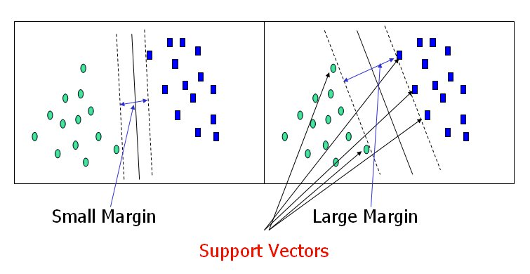
Why “Support Vector Machine”?
worse
decision
boundary
better
decision
boundary

Slide 15
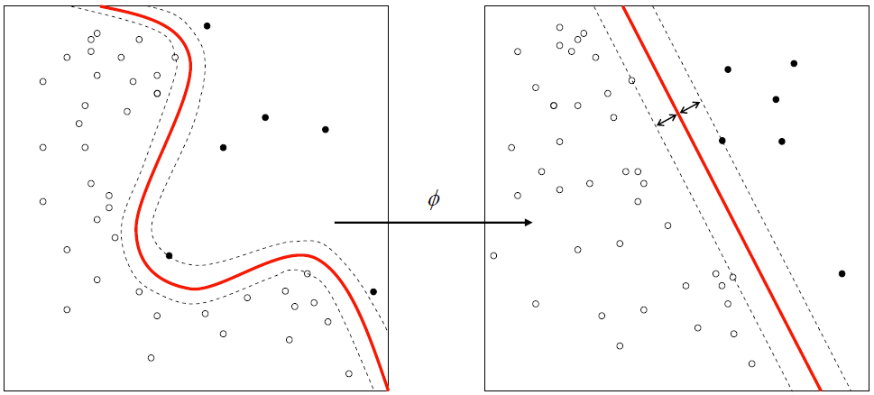
SVMs can make more complex decision boundaries by using kernels
kernel

Slide 16
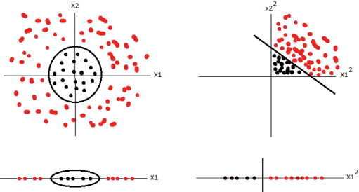
Kernel
A kernel performs a mathematical operation on instances in two classes that are not linearly separable, so that they do become linearly separable

Slide 17
Kernel = Similarity Measure
A kernel takes pairs of instances and determines their similarity\
There are many kernels
The proper choice of a kernel depends on the domain
The “linear kernel” (actually no kernel) is the simplest version
The linear kernel should be used especially when you have many features (recall the previous lecture)

Slide 18

Kernels
Linear
Polynomial
Radial Basis Function
Sigmoid

Slide 19
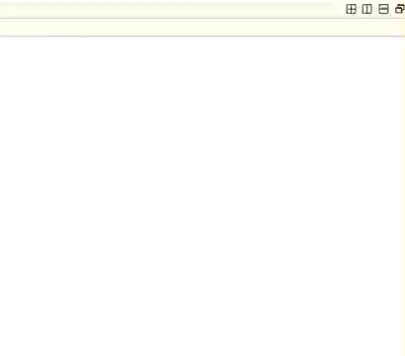
Kernels
Linear
Polynomial
Radial Basis Function
Sigmoid

Slide 20

Orange

Slide 21
Cost of misclassification
Number of support vectors

Slide 22
C = Cost parameter (misclassification cost)
https://www.quora.com/What-are-C-and-gamma-with-regards-to-a-support-vector-machine

Slide 23
XOR dataset (create using Paint Data)

Slide 24
Experimenting with SVMs (XOR dataset)

Slide 25
Spirals dataset

Slide 26
Experimenting with SVMs (spirals dataset)

Slide 27
Comparative Evaluation on any dataset
Please note:
Use 5 or 10 fold CV when comparing with Majority classifier!
NOT leaving one out CV

